Slide 1
Physical Chemistry
Ying Hu
(Fifth edition)
Bilingual Program
版权所有：华东理工大学物理化学教研室

Slide 2
Part V Extension
Chapter 17
Electrochemistry
Bilingual Program
版权所有：华东理工大学物理化学教研室

Slide 3
17. Electrochemistry
17.1 Introduction
I. Electrochemical Equilibria
17.2 Electromotive Force of Galvanic Cell and Interfacial Potential Difference
17.3 Thermodynamics of Electrochemical Systems
17.4 Potential and Standard Potential of Cell Reaction
17.5 Potential and Standard Potential of Electrode Reaction
17.6 Various Types of Electrodes and Standard Cell
17.7 Electrochemical-Equilibrium Calculations
17.8 Concentration Cell and Liquid-Junction Potential
II. Theories of Electrode-Solution Interface
17.9 Outer Potential, Surface Potential and Inner Potential
17.10 Surface Excess Charge and Double-Layer Capacitance
17.11 Electric Double-Layer Models and Outer Potential
17.12 Absolute Potential of Electrode Reaction
III. Electrochemical Kinetics
17.13 Relations among Reaction Rate, Current and Potential
17.14 Polarization Phenomena and Over-Potential
17.15 Examples of Application
17.16 Transition-State Theory of Electrode Reactions

Slide 4
17.1 Introduction
A-
C+
A+
C-
galvanic cell
electrolytic cell
spontaneous reaction
Nonspontaneous reaction
Redox reaction
Oxidation
Reduction
Anode
Cathode
Half reaction: Ox +ν e⁻ → Red

Slide 5
17.1 Introduction
The difference between electrochemical reactions and ordinary reactions
(2) Thermodynamic Characteristics of Electrochemical Reactions
Ordinary reactions
Electrochemical reactions
(3) Kinetic Characteristics of Electrochemical Reactions
Reaction rates are strongly affected by the inner-potential difference in general or the terminal voltage for an electrolytic cell

Slide 6
17.2 Electromotive Force of Galvanic Cell and Interfacial Potential Difference
Summary
Inner potential
Cell potential
Electromotive Force
E
When I = 0
Contact Potential
Liquid-Junction Potential
Different electrolytes
Different concentrations
Salt bridge

Slide 7
16. Electrolyte Solutions
I. Electrochemical Equilibria
17.2 Electromotive Force of Galvanic Cell and Interfacial
Potential Difference
17.3 Thermodynamics of Electrochemical Systems
17.4 Potential and Standard Potential of Cell Reaction
17.5 Potential and Standard Potential of Electrode Reaction
17.6 Various Types of Electrodes and Standard Cell
17.7 Electrochemical-Equilibrium Calculations
17.8 Concentration Cell and Liquid-Junction Potential

Slide 8
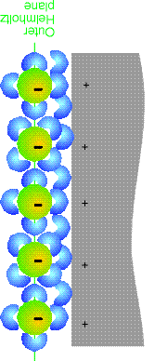
17.3 Thermodynamics of Electrochemical Systems
1. Thermodynamic Fundamental Equations of Electrochemical Systems
A heterogeneous system with changeable compositions, each phase of it possesses a certain inner potential.
The electrochemical potential
z_{i}
z_{i}

Slide 9
17.3 Thermodynamics of Electrochemical Systems
1. Thermodynamic Fundamental Equations of Electrochemical Systems
The electrochemical potential
The thermodynamic fundamental equations

Slide 10
17.3 Thermodynamics of Electrochemical Systems
3. Electrochemical Equilibria
Electrochemical Equilibrium Criterion
Phase-Equilibrium Criterion

Slide 11
16. Electrolyte Solutions
I. Electrochemical Equilibria
17.2 Electromotive Force of Galvanic Cell and Interfacial
Potential Difference
17.3 Thermodynamics of Electrochemical Systems
17.4 Potential and Standard Potential of Cell Reaction
17.5 Potential and Standard Potential of Electrode Reaction
17.6 Various Types of Electrodes and Standard Cell
17.7 Electrochemical-Equilibrium Calculations
17.8 Concentration Cell and Liquid-Junction Potential

Slide 12
17.4 Potential and Standard Potential of Cell Reaction
1. Potential of Cell Reaction
Derivation

Slide 13
17.4 Potential and Standard Potential of Cell Reaction
1. Potential of Cell Reaction
Definition
E is solely determined by the reaction, i.e., by the chemical potentials of various substances participating in the reaction
Only approximately, E_{cell} can be regarded as the electromotive force
The cell potential is a potential in either equilibrium or non-equilibrium condition. The potential of cell reaction or the electromotive force of a cell is the potential in equilibrium condition when the current is zero.
A perfect writing should point out the reaction and the concentrations of various substances.
E is an intensive property, Δ_{r}G_{m} depends on the writing of the cell reaction, and they are unified by the reaction charge number.

Slide 14
17.4 Potential and Standard Potential of Cell Reaction
2. Standard Potential of Cell Reaction
Definition
The standard states selected are usually as the solid, liquid pure substance and the gaseous pure substance in an ideal-gas state, and the pure water, at the system temperature and a pressure of (0.1 MPa). For ions, the solute ion in an ideal dilute solution of =1mol⋅kg⁻¹ or =1mol⋅dm⁻³ is adopted.

Slide 15
17.4 Potential and Standard Potential of Cell Reaction
3. Nernst Equation
Derivation

Slide 16
17.4 Potential and Standard Potential of Cell Reaction
3. Nernst Equation
For the reaction of a Daniel cell,
Because Zn and Cu are pure substances, a_{Zn}=a_{Cu}=1,
For a gaseous component i, the corresponding activity is replaced by the reduced fugacity or reduced partial pressure

Slide 17
17.4 Potential and Standard Potential of Cell Reaction
3. Nernst Equation
The activities in the Nernst equation are usually replaced by the molarities
is called the conditional potential of cell reaction.
It contains the contribution of the activity factors, and depends on the concentrations of various components.

Slide 18
17.4 Potential and Standard Potential of Cell Reaction
4. Temperature Dependence of Potential of Cell Reaction
Temperature coefficient of cell reaction
Molar enthalpies of reaction

Slide 19
17.4 Potential and Standard Potential of Cell Reaction
4. Temperature Dependence of Potential of Cell Reaction
Comparison of molar enthalpies of reaction by EMF method and calorimetry
Reaction
EMF
calorimetry

Slide 20
17.4 Potential and Standard Potential of Cell Reaction
4. Temperature Dependence of Potential of Cell Reaction
Experimental Determination
Calculation

Slide 21
17.4 Potential and Standard Potential of Cell Reaction
Example 1
For a cell
at 25°C, the potential of cell reaction, E=0.67533V, the temperature dependence, (∂E/∂T)_{p}= −6.5×10⁻⁴V⋅K⁻¹. Calculate Δ_{r}G_{m}, Δ_{r}S_{m}, Δ_{r}H_{m} at 25°C for the reaction of

Slide 22
17.4 Potential and Standard Potential of Cell Reaction
Solution
Δ_{r}H_{m} = Δ_{r}G_{m} − TΔ_{r}S_{m} =[−130.32+298.2×(−125) ×10⁻³]kJ⋅mol⁻¹
= −167.6kJ⋅mol⁻¹
Calorimetry result: Δ_{r}H_{m}= −165.4kJ⋅mol⁻¹

Slide 23
17.4 Potential and Standard Potential of Cell Reaction
Example 2
(1) Calculate the potential of cell reaction at 25°C and its temperature coefficient for a cell:
For H₂O(l), the standard molar enthalpy of formation is −285.85 kJ⋅mol⁻¹, the standard molar Gibbs function of formation is −237.14 kJ⋅mol⁻¹.
(2) Calculate the potential of cell reaction of the above cell at 0°C.

Slide 24
17.4 Potential and Standard Potential of Cell Reaction
Solution
Cathode
Anode
Cell reaction
(1)
(2)At 25°C,
At 0°C,

Slide 25
17.4 Potential and Standard Potential of Cell Reaction
Example 3
For a cell
At 298 K, E = 0.0454 V
(1) What are the electrode reactions and the cell reaction?
(2) Calculate at 298 K.
(3) When the cell have the temperature coefficient of
If there is 1 F electricity pass through the cell,

Slide 26
17.4 Potential and Standard Potential of Cell Reaction
Solution
(1)
Cathode
Anode
cell reaction
(2) All the substance are at their standard state
(3)

Slide 27
16. Electrolyte Solutions
I. Electrochemical Equilibria
17.2 Electromotive Force of Galvanic Cell and Interfacial
Potential Difference
17.3 Thermodynamics of Electrochemical Systems
17.4 Potential and Standard Potential of Cell Reaction
17.5 Potential and Standard Potential of Electrode Reaction
17.6 Various Types of Electrodes and Standard Cell
17.7 Electrochemical-Equilibrium Calculations
17.8 Concentration Cell and Liquid-Junction Potential

Slide 28
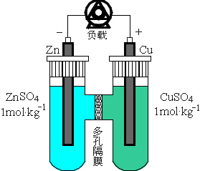

17.5 Potential and Standard Potential of Electrode Reaction
The absolute value of the inner-potential difference of a single electrode can not be determined accurately.
select a reference electrode. The inner-potential differences of various electrodes relative to it are then used to replace the absolute values.
A standard hydrogen electrode serves as a reference electrode.

Slide 29
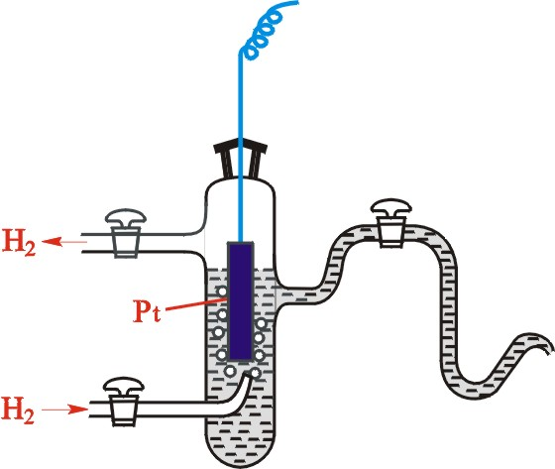
17.5 Potential and Standard Potential of Electrode Reaction
1. Standard Hydrogen Electrode (SHE)
Electrode reaction
,
It should always be in terms of the reduction direction

Slide 30
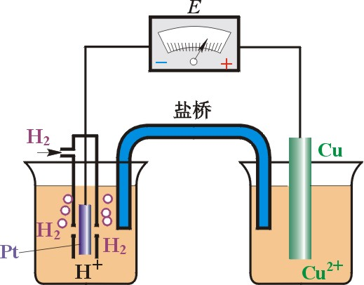
17.5 Potential and Standard Potential of Electrode Reaction
2. Standard Potential of Electrode Reaction
Definition
Salt bridge
Example
For the copper electrode

Slide 31
17.5 Potential and Standard Potential of Electrode Reaction
Written Conventions
The symbol of the electrode is always from solution to electrode,
The electrode reaction should be written in reduction direction.
×
×

Slide 32
17.5 Potential and Standard Potential of Electrode Reaction

Slide 33
17.5 Potential and Standard Potential of Electrode Reaction

Slide 34
17.5 Potential and Standard Potential of Electrode Reaction
3. Potential of Electrode Reaction
Definition
The potential of cell reaction of this cell is defined as the potential of electrode reaction of this specified electrode with a symbol of E{⋅⋅⋅} similar to {⋅⋅⋅} but the concentrations and the partial pressures of various substances should be noted.
Example

Slide 35
17.5 Potential and Standard Potential of Electrode Reaction
4. Nernst Equation for Electrode Reaction
Suppose an electrode reaction
Composing a galvanic cell with a standard hydrogen electrode
The difference between E and is related with the activities of the substances of oxidation and reduction states in the electrode reaction.

Slide 36
17.5 Potential and Standard Potential of Electrode Reaction
4. Nernst Equation for Electrode Reaction
Example
Case I
For pure solids and liquids, such as Cu, a_{Cu}=1
Case II
For gases, the relative fugacity or partial pressure is used to replace the activity,

Slide 37
17.5 Potential and Standard Potential of Electrode Reaction
5. Relation between Potential of Cell Reaction and Potentials of Electrode Reaction
Example
For the Daniel cell, the Nernst equations for the electrode reactions of the positive and the negative electrodes are
Positive
electrode
Negative
electrode

Slide 38
17.5 Potential and Standard Potential of Electrode Reaction
5. Relation between Potential of Cell Reaction and Potentials of Electrode Reaction
Nernst Equation

Slide 39
17.5 Potential and Standard Potential of Electrode Reaction
Standard Hydrogen Electrode (SHE)
Standard Potential of Electrode Reaction
Nernst Equation for Electrode Reaction

Slide 40
17.5 Potential and Standard Potential of Electrode Reaction
5. Relation between Potential of Cell Reaction and Potentials of Electrode Reaction
Nernst Equation

